Slide 1
Background: SIRT5 metabolomics
Allie Mills
1.27.2020

Slide 2
Sirtuin 5
TCA cycle
FAO
AA metabolism
ROS response
Urea Cycle
Glycolysis
acyl
Sirt5
Malonyl
Glutaryl
Succinyl
Substrate
Substrate
NAD⁺
NAM
O-acyl-ADPR
Notes:
Phylogenetically distinct from other sirtuins
Lysine conjugate acyl modifications are reversible PTMs
Affinity for negatively charged acyl modifications
Sirtuins are traditionally thought of as stress response proteins
No evidence of CCNF being a succinylated (or acylated modifications)
Particularly interested in Sirt5’s role in stress response seeing as CCNF is very sensitive to stress and maybe it could be coupling the cell cycle to stress response pathways

Slide 3
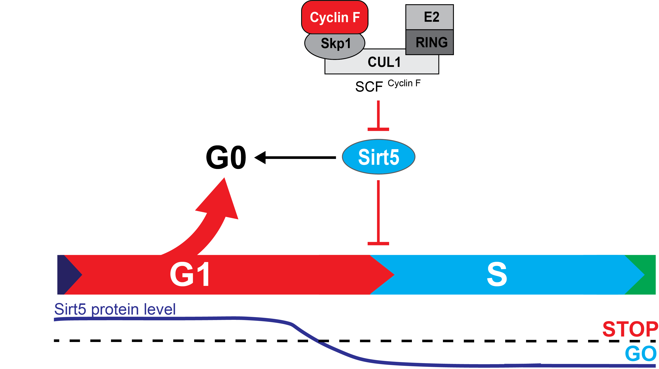
Notes:
So how does this change our model?
So now the question becomes What does this all mean physiologically?
Based on the data we have and our model, we thought we may want to look for cell types that cycle between G0 and active cycling. This is what led us to Stem cells

Slide 4
Sirt5 stability in the absence of Cyclin F

Slide 5
Notes:
So how does this change our model?
So now the question becomes What does this all mean physiologically?
Based on the data we have and our model, we thought we may want to look for cell types that cycle between G0 and active cycling. This is what led us to Stem cells

Slide 6
Sirt5 levels influence G1 progression
G1/G0
S
G2/M
Notes:
To test whether Sirt5 KO altered cell cycle distribution, we started by blotting cyclins

Slide 7
Notes:
So how does this change our model?
So now the question becomes What does this all mean physiologically?
Based on the data we have and our model, we thought we may want to look for cell types that cycle between G0 and active cycling. This is what led us to Stem cells

Slide 8
Outstanding Question:
How does SIRT5 influence cell cycle progression?
Notes:
So how does this change our model?
So now the question becomes What does this all mean physiologically?
Based on the data we have and our model, we thought we may want to look for cell types that cycle between G0 and active cycling. This is what led us to Stem cells
NEAAs consumed in G0-G1 transition, EAAs consumed in G1-S transition

Slide 9
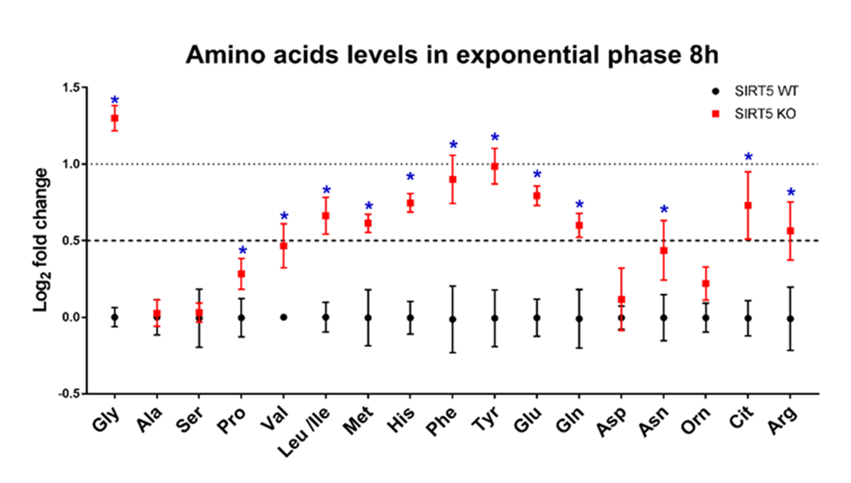
Sirt5 KO cells have reduced AA catabolism
Leucine Oxidation
Lysine Oxidation
Dhaval Bhatt

Slide 10
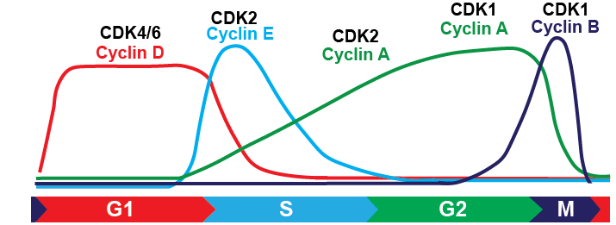
Cell Cycle
Transcription
& translation
Targeted protein degradation
Key point
protein degradation is a vital mechanism driving cell cycle progression
defects in protein degradation contribute to cancer phenotypes
p53, HIF, c-Myc, Nrf2, IkB, Notch, Cyclin E, etc.
Notes:
May cut this slide

Slide 11
Sirtuin 5 protein levels absence of Cyclin F
HeLa

Slide 12
Outstanding Question:
Does Sirt5 regulate any metabolic pathways that may influence cell cycle?
Notes:
So how does this change our model?
So now the question becomes What does this all mean physiologically?
Based on the data we have and our model, we thought we may want to look for cell types that cycle between G0 and active cycling. This is what led us to Stem cells
NEAAs consumed in G0-G1 transition, EAAs consumed in G1-S transition

Slide 13
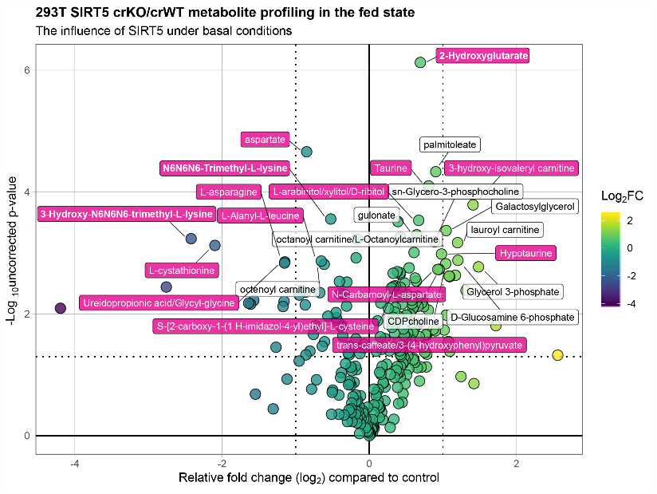
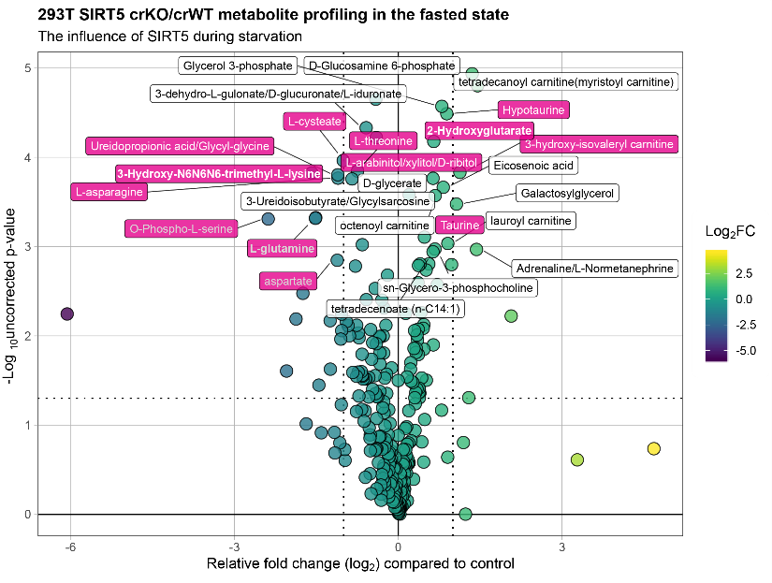
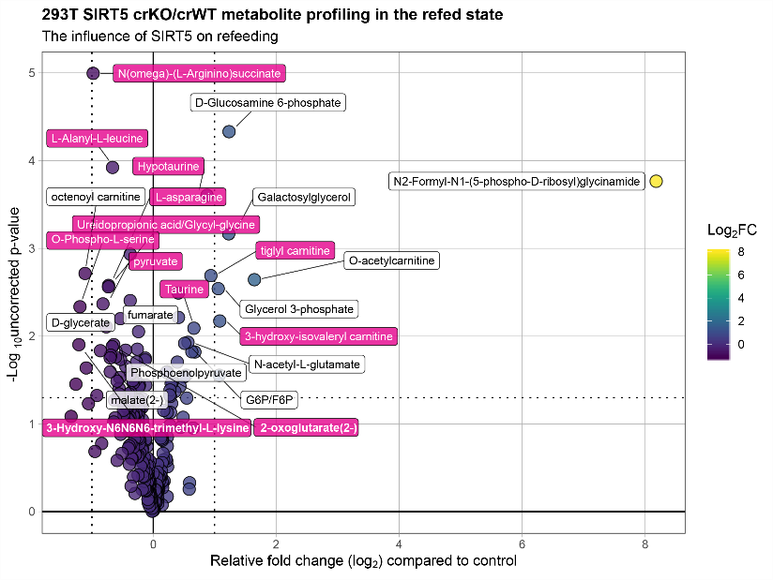
Fed
Fast
Refed
SIRT5 crWT
SIRT5 crKO
DMEM
2h EBSS
2h EBSS+
1h DMEM
MBX
Analysis of WT vs KO

Slide 17

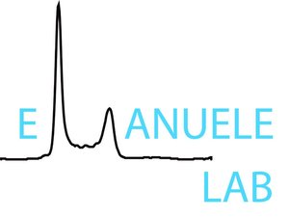
Acknowledgements
Matthew Hirschey
Darren Stuart, M Sc
Kristin Anderson, PhD
Zhihong Lin
Alec Trub
Keith Keenan
Dhaval Bhatt, PhD
DMPI
DCI Flow Core
Paul Grimsrud
James Draper
Jim White Lab
David Lee, PhD
Michael Emanuele (UNC)
Xianxi Wang
Ryan Mouery
Thomas Bonacci, PhD
Courtney Cannon*
Raj Choudhury, PhD*
DiCaprio Lab (Dana Farber)
Funding
Nephrology NIH T32

